Slide 1
Diversity-Sensitive Introduction
to Courses
Ideas for Presentations

Slide 2
Diversity-Sensitive Introduction to Courses
Dear Lecturers,
Based on the FAU Awareness Toolkit, these slides offer suggestions for a diversity-sensitive start to your course. They are designed to help you:
Minimize barriers right from the start of your course
Highlight resources for support
Establish a diversity-sensitive mindset – not only for this course, but also for how students interact in their daily lives and future careers
In addition, you will find guidelines at the end of the presentation on how to design accessible and inclusive courses.
Slides 4-6 are particularly relevant for the introduction to the course. Feel free to adapt them as you see fit to your specific needs and the course schedule, and use them flexibly. If necessary, you can, of course, add additional slides from the appendix.
We would appreciate your feedback on how you use these materials, any adaptations you make, and the content itself, so that we can continue to tailor this resource to your needs.
Please write an e-mail to Harriet Ziegler (Diversity Management): harriet.ziegler@fau.de

Slide 3
Slides for Courses
Notes:
Background Information
Addressing Students
A person’s gender isn’t always apparent from their name. Additionally, for non-binary* or trans* students, the name listed on the registration form may not be the name they use in everyday life.
At the beginning of the semester, ask students which pronouns and (first) names they prefer to be addressed by. This can be done, for example, in a simple way by including a column in the course list.
As an instructor, you can, for example, choose a gender-sensitive form of address by the (chosen) first name, thereby avoiding the titles “Ms. … / Mr. ….”
(https://www.equality-and-diversity.fau.eu/files/2025/03/Checklist-E.pdf)
Special Requirements and Needs
The focus here is on students’ special needs and life circumstances. First, this concerns the organization of coursework – such as deadlines or attendance requirements – which can be difficult to meet. Second, it concerns potential disabilities, such as visual or hearing impairments, ADHD, or chronic illnesses, which may affect the use of media and require the instructor to modify the seminar format.
Be open-minded and solution-oriented when it comes to your own course, and consider possible adjustments (e.g., offering courses in a hybrid format in cases of caregiving responsibilities or chronic illnesses).
Inform students about the option of receiving compensation for disadvantage (e.g., in the form of extra time) and provide easy-to-access ways for them to request these compensations or learn more about them. The counseling centers are available to provide guidance to both students and instructors. If a compensation has already been approved, students are advised to inform the examiner after registering for the exam, but no later than one week before each exam, that they have been granted a compensation for disadvantage and what they require to take the exam in accordance with the approved arrangement.
Contact
beeintraechtigt-studieren@fau.de
Information on Compensation for Disadvantages
https://www.fau.eu/studying/organizing-your-studies-and-where-to-go-for-advice/studying-with-special-requirements/studying-with-a-disability-or-chronic-illness/
Accessible Teaching
https://www.equality-and-diversity.fau.eu/diversity/inklusion-an-der-fau/barrierearme-lehre-informationen-fuer-lehrende-und-studierende/barrierefreie-lehre/
First-Generation Students
https://www.fau.eu/studying/organizing-your-studies-and-where-to-go-for-advice/studying-with-special-requirements/first-generation-students/
Family Office/Maternity During Studies
https://www.familienservice.fau.eu/ and https://www.fau.eu/studying/organizing-your-studies-and-where-to-go-for-advice/studying-with-special-requirements/pregnancy-and-maternity-protection-while-at-university/
Anti-Discrimination
https://www.equality-and-diversity.fau.eu/diversity/antidiskriminierung/
Accessibility
Communicate your commitment to accessible course design. At the beginning of the semester, make it clear that you are willing to make the course accessible. This allows students with special needs to reach out to you early on.
Clarify specific requirements: Whenever possible, ask students about their individual needs and requirements (e.g., for students with visual, hearing, or mobility limitations). Provide materials early: Make materials available well in advance to give students with disabilities enough time to prepare. This is especially important for students with learning disabilities or chronic health conditions.
Resources
Accessible Documents: https://www.university-press.fau.de/en/wegweiser-barrierefreiheit/
Accessible courses: https://sites.augsburg.edu/events/policies/accessible-events/planning-an-accessible-event-check-list/

Slide 4
To get started with our course
Please take a moment to think about the following:
How would you like to be addressed?
How would you like to address each other? (e.g., first name, last name…)
If any of the following apply to you, please get in touch:
Are you in a life situation that requires special arrangements for your studies?
Do you have special needs that should be taken into account in the course’s instructional design, such as those related to hearing or vision?
For general questions:
The following slides provide information on university support services and contact persons.

Slide 5
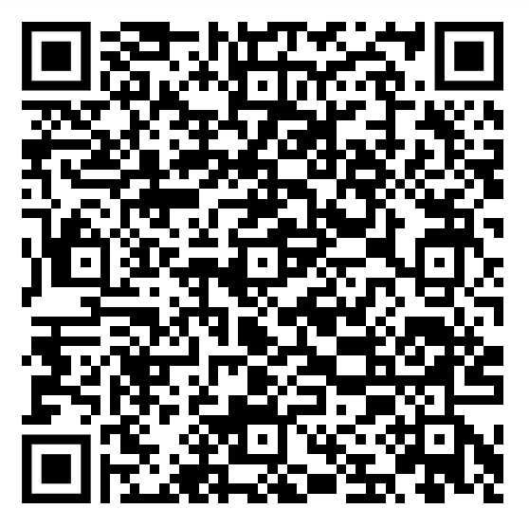
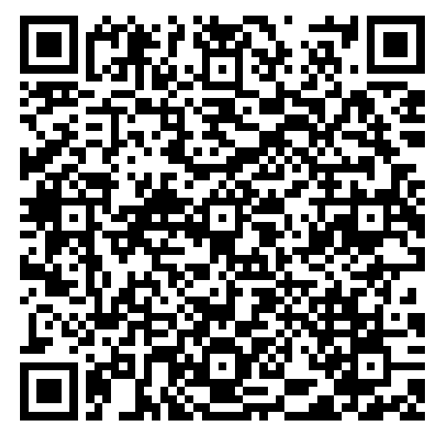
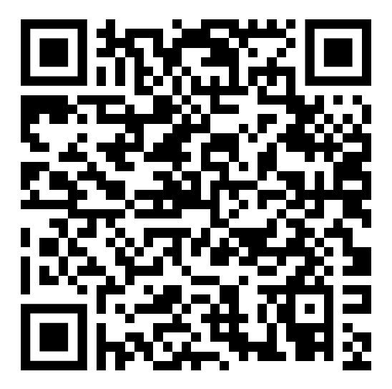
Support and Points of Contact
Compensation for disadvantages for chronic illness or disability: Contact beeintraechtigt-studieren@fau.de as early as possible before the exam.
If you have experienced or witnessed boundary violations, harassment, discrimination, or violence by other students, please speak confidentially with your instructor or one of the contact persons for protection against discrimination and (sexual) harassment.
If you have experienced or witnessed such behavior by a faculty member: Contact the program coordinator, the dean of studies, the women’s representative, or FAU’s central counseling office.
Compensation
for
disadvantages
Counseling
services
and contacts
Information
and Student
Advisory
Services

Slide 6
Code of Conduct (Draft – Feel free to adapt)
By participating in this course, all participants commit to treating one another with respect and consideration in both words and actions. No one may be disadvantaged, insulted, belittled, or discriminated against on the basis of gender, appearance, skin color, social or cultural background, gender identity, sexual orientation, age, or disability. All attendees agree to be vigilant against any form of (sexual) harassment, discrimination, and violence in the context of the course, to respect the boundaries of others at all times, and to firmly advocate for the observance of appropriate conduct.
Notes:
https://www.equality-and-diversity.fau.eu/files/2025/03/Checklist-E.pdf

Slide 7
Appendix

Slide 8
Suggestions for Instructors
Reflecting on One’s Own Role and Responsibilities
What is my role in this course?
What are my responsibilities in this role?
What is the scope of my influence?
Which of my words and actions might be perceived by others as crossing boundaries or causing harm?
What specific actions can I take (or refrain from taking) to help create a respectful and equitable environment?
At FAU, we promote a healthy and respectful course culture and strive at all times to create an inclusive and respectful environment through our words and actions.
You can find more information on awareness-raising efforts in the context of courses in this checklist from the Awareness Toolkit.

Slide 9
Awareness Toolkit Resources and Counseling Services at a Glance
FAU Awareness Materials
Awareness Toolkit
Awareness Handout
Awareness Glossary
Awareness Checklists
Counseling Services
Discrimination and (Sexual) Harassment
Women‘s Representatives
Family Service
Student Advice Center
Studying with a Disability or Chronic Illness
First-Generation Students
Pregnancy and Maternity Protection while at University

Slide 10
Accessible
Communication
Helpful Tools, Apps, and Tutorials
Website Accessibility Review
Checking the Contrast
in a Document
Accessible
Documents and Scans
H5P and Collaborative Writing Tools
Checking the Readability of Documents
Subtitle Generation for Videos
Collection of tutorials on various programs
Audiovisual Media
Accessibility in Digital Teaching
Creating Accessible Documents
Planning
Accessible Events

